Slide 1


HI5TREASURES._.PKR ( AN ECOMMERCE WEBSITE FOR GIFT SHOP )
JANAPRIYA MULTIPLE CAMPUS
Submitted for the partial fulfillment of the requirements for the degree of Bachelor of Information Management(BIM)
PRESENTED BY:
KRISHNA LUHARUKA(12435/20)
6th Semester
SUPERVISED BY:
MR. MEKH RAJ POUDEL
Faculty of Management, Tribhuvan University
May, 2024

Slide 2
AGENDA
About The Website
Introduction
Purpose of Creating Website
Problem Statement
Features
Methodology
Tools and technology Used
Figures and Tables
Requirement Analysis (Use case diagram)
Process Modelling (Activity, DFD, Sequence diagram)
Data Modelling (E-R diagram)
System Design (Flowchart, Class diagram)
Testing (Test Cases)
Conclusion

Slide 3
ABOUT THE WEBSITE

Slide 4
INTRODUCTION:
HI5TREASURES._.PKR, an online gift shop.
No browsing option and customization on display of products.
Disorganization of orders.
Choosed the topic as I am indulged in this organization.
The website aims to optimize SEO and attract organic traffic.
Improve customer experience and satisfaction.

Slide 5
PURPOSE OF CREATING THE WEBSITE:
To showcase the products in desired manner.
Provide advance search and filter options.
Responsible to offer multiple customer support options.
Enable the shop to create a unique brand identity.
Optimize the user experience.
Better organization of resources, orders, payments and users.

Slide 6
PROBLEM STATEMENT:
At present, the organization is facing problems in attracting customers despite it exclusive products due to:
Limitation on customization and control over presentation of products.
Limited access to detailed customer data and analytics
Lack of organization of products, categories, orders, payments and users.
Social media account has limited impact on search engine visibility.

Slide 7
FEATURES:
This project has two modules i.e, user and admin.
Admin Module:
Admin Dashboard:
Home Page:
About Us:
Search Bar:
Reviews:
User Module:
Search Bar:
Home Page:
About Us:
Reviews:
Contact Us:
Cart:
User Dashboard:

Slide 8
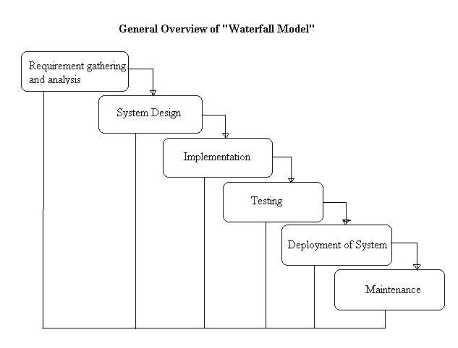
METHODOLOGY:
Mainly, Waterfall approach is used.
Also includes incremental model.
Whole process divided into separate phases.
The outcome of one phase acts as input for the next phase sequentially.

Slide 9
TOOLS AND TECHNOLOGIES USED:
IDE: Visual Studio Code
Database: MySQL
Database server implementation: XAMPP
Web server: Apache
Back End: PHP
Language: HTML/CSS /JavaScript/PHP

Slide 10
DIAGRAMS
Understanding the complex systems

Slide 11
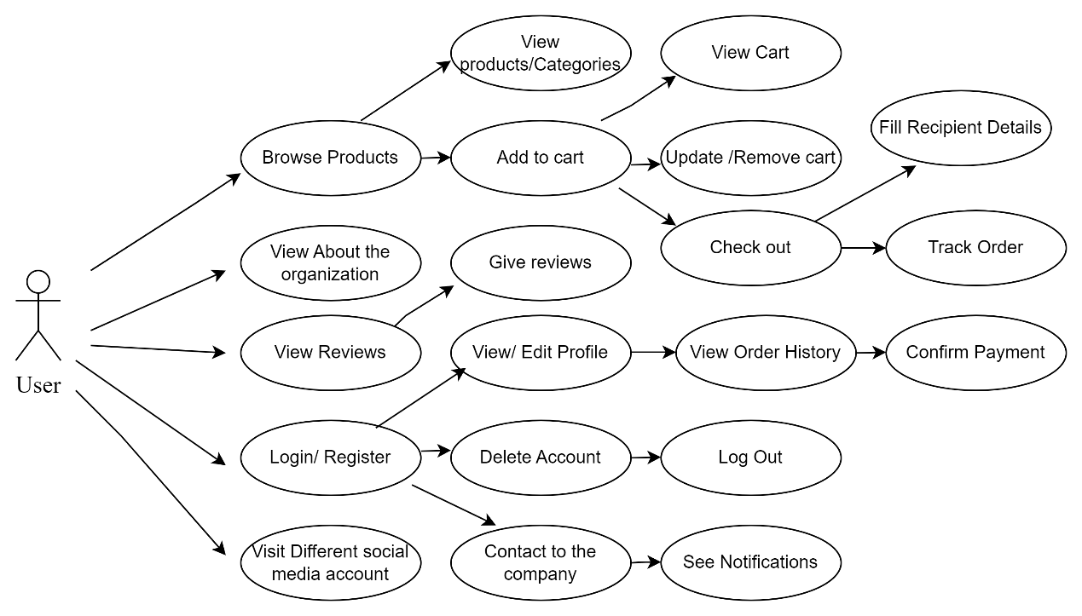
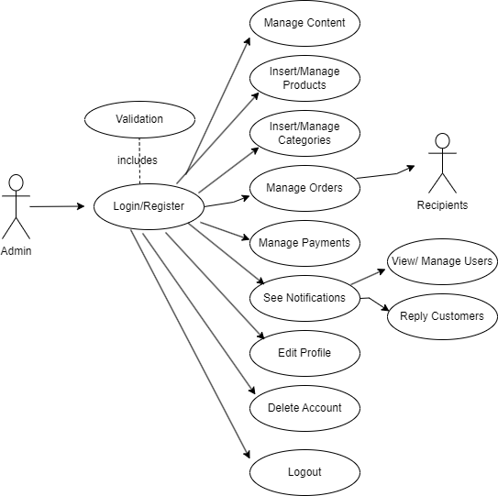
USE-CASE DIAGRAM:
USER USE-CASE DIAGRAM
ADMIN USE-CASE DIAGRAM

Slide 12
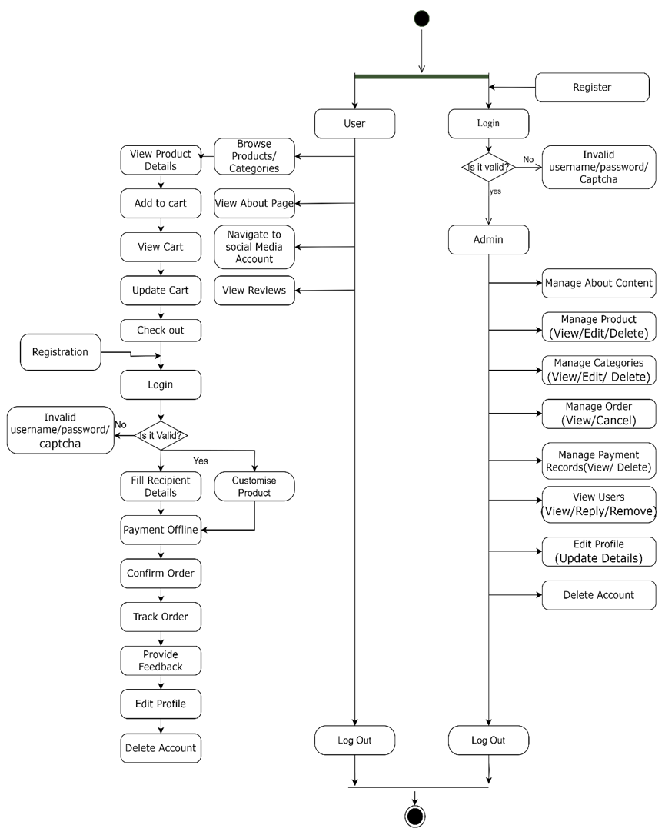
ACTIVITY DIAGRAM:

Slide 13
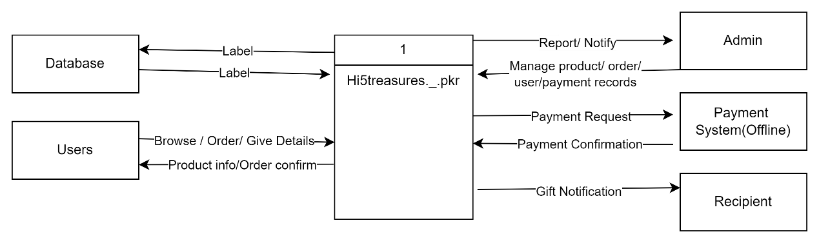
DFD DIAGRAM:

Slide 14
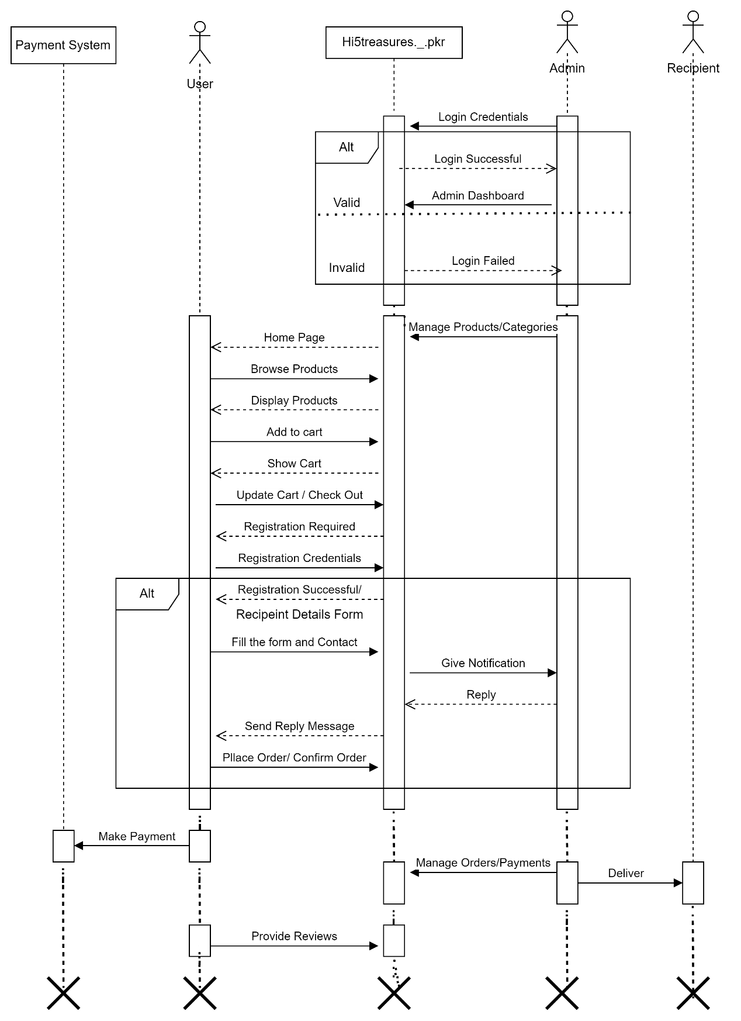
SEQUENCE DIAGRAM:

Slide 15
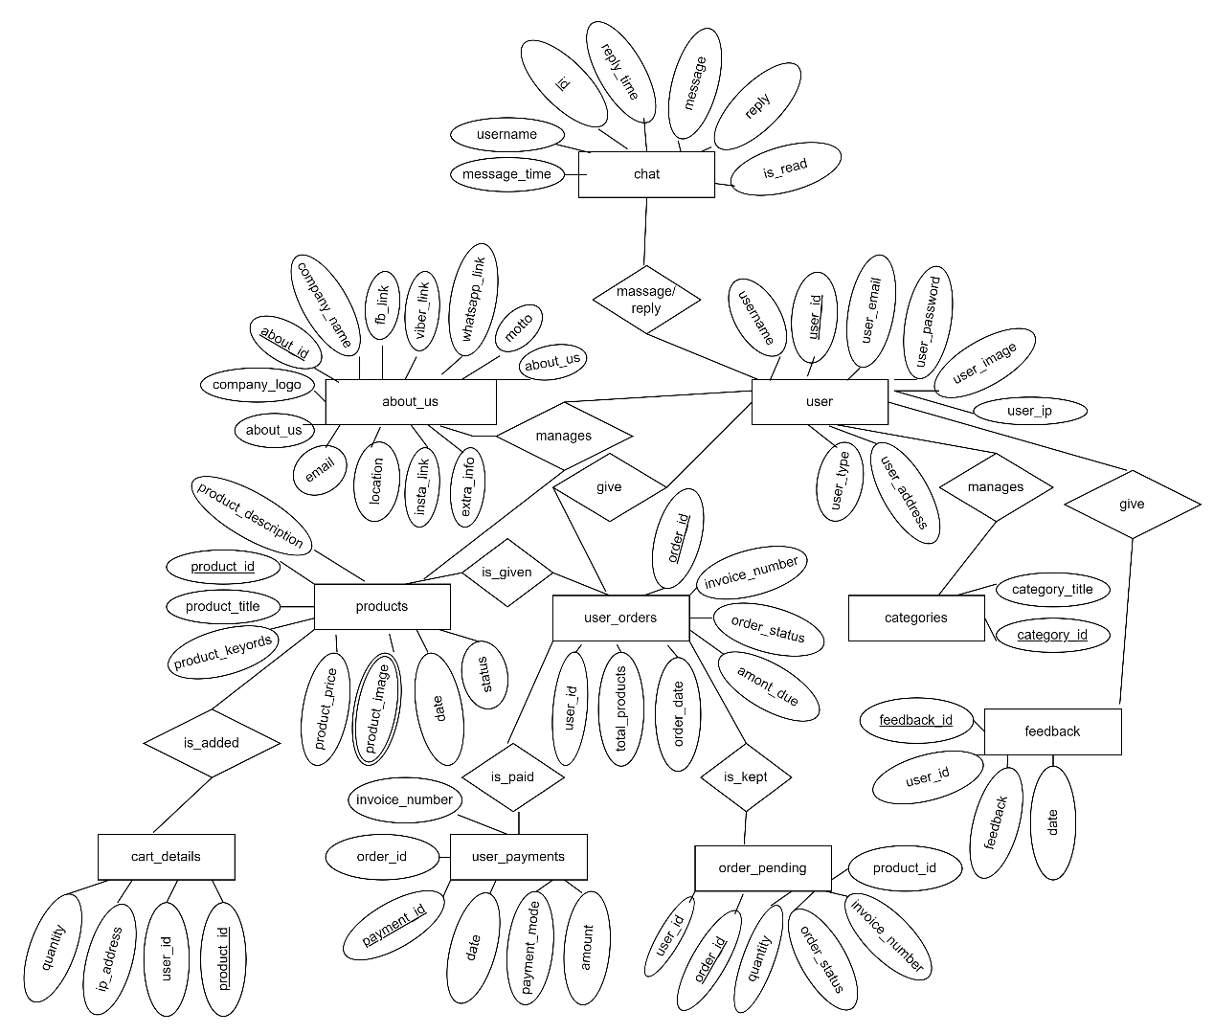
E-R DIAGRAM:

Slide 16
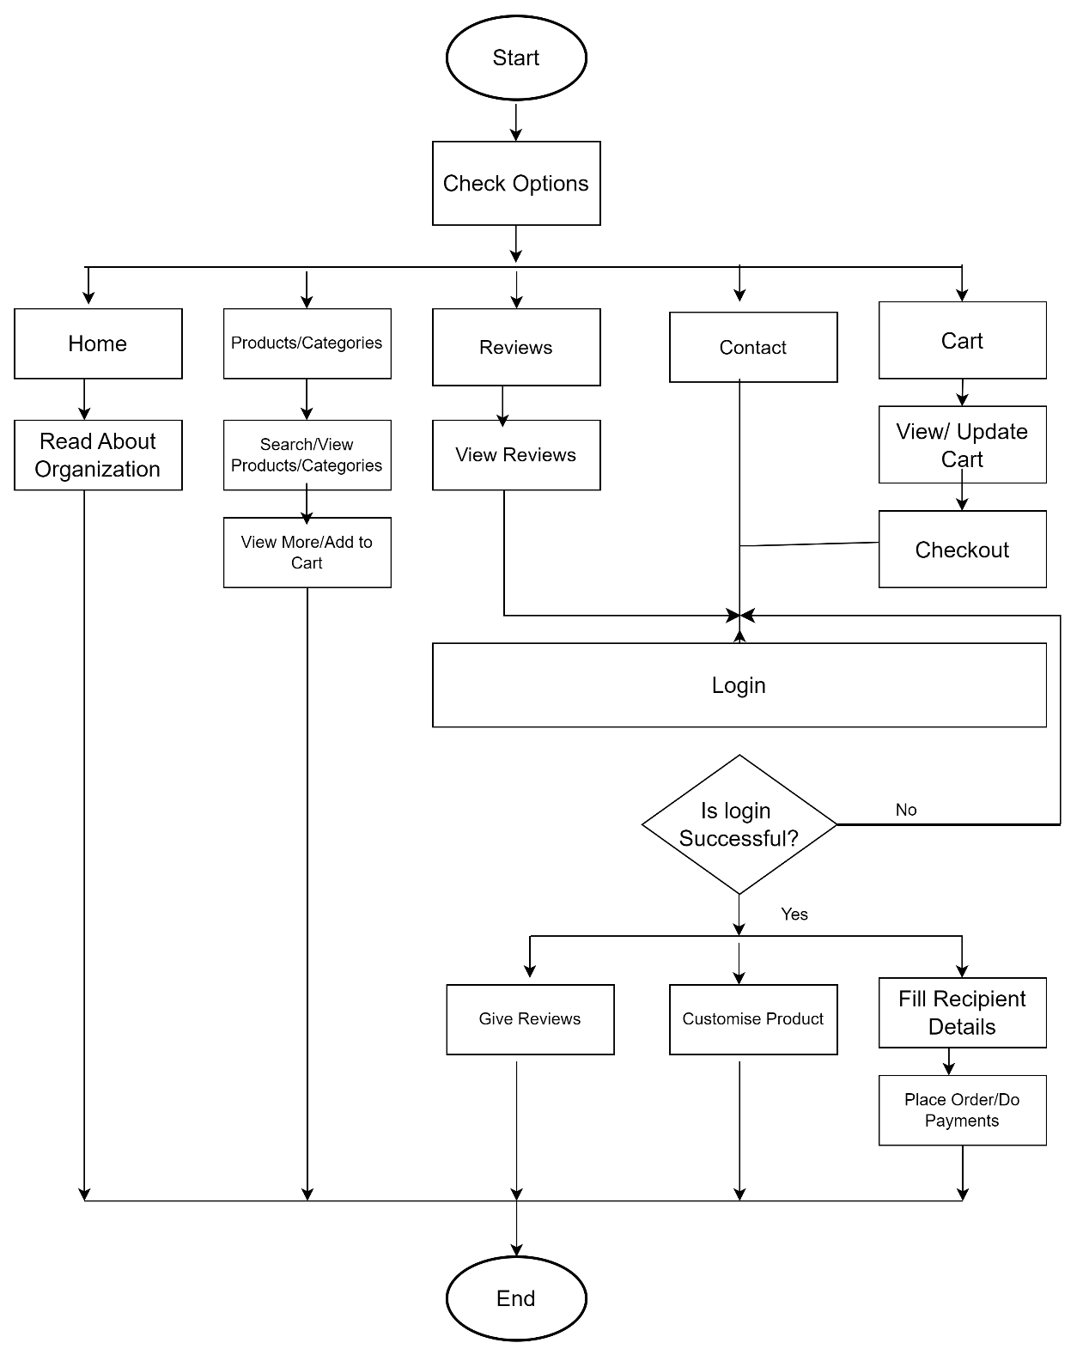
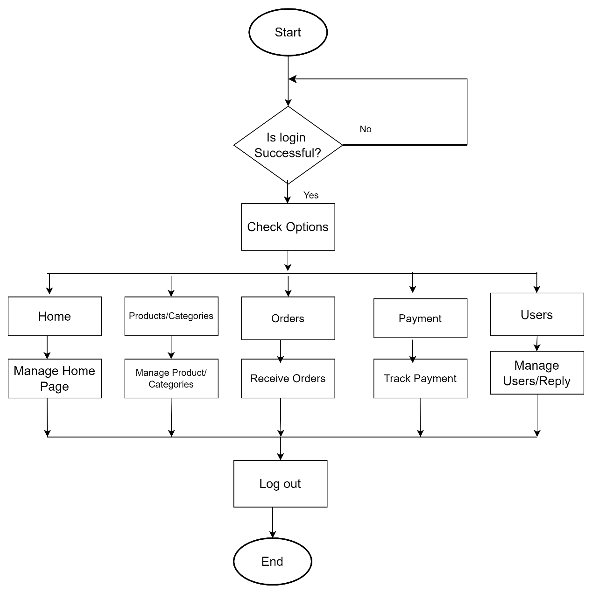
FLOWCHART:
ADMIN FLOWCHART
USER FLOWCHART

Slide 17
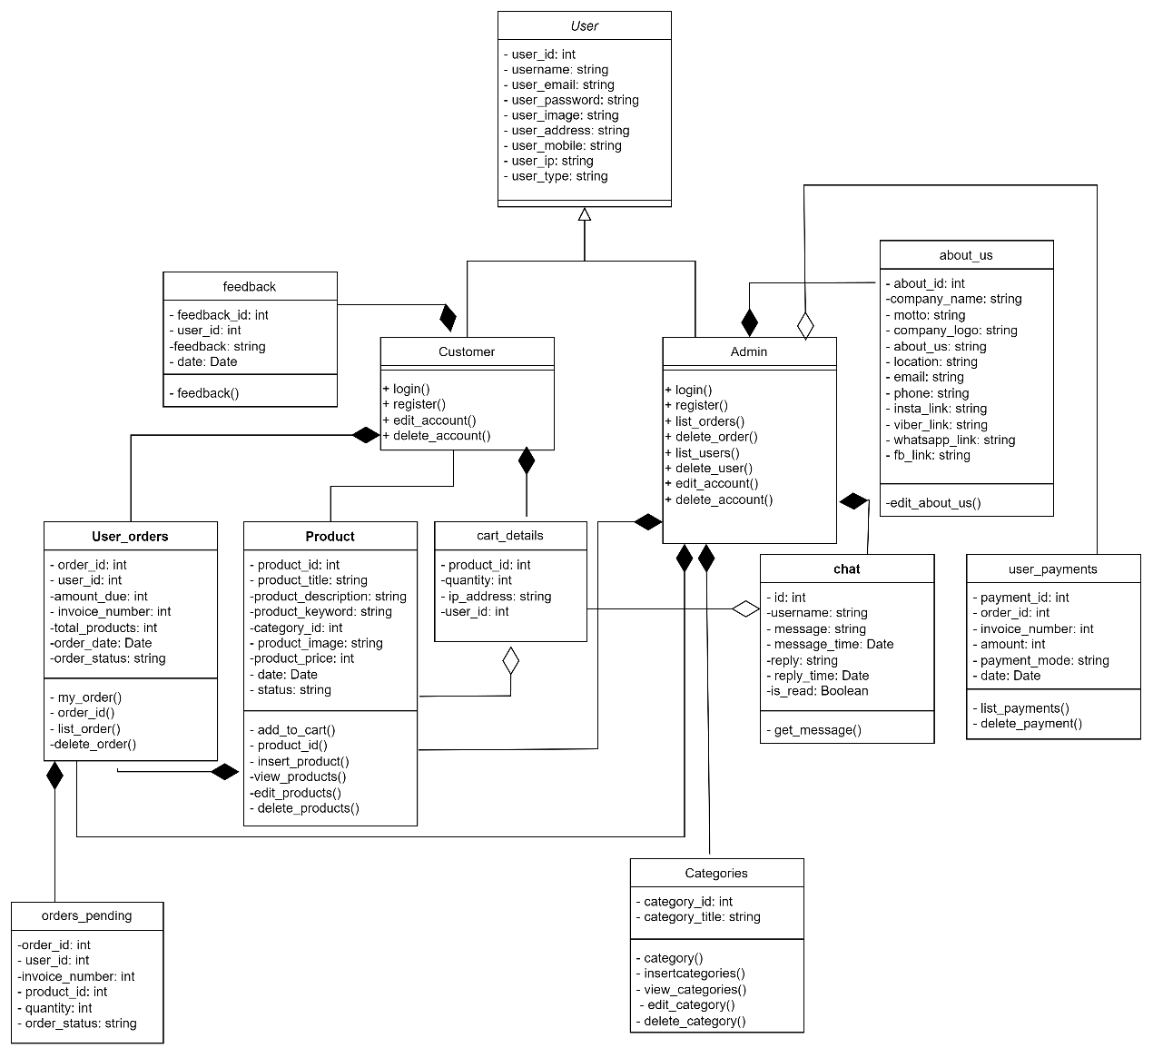
CLASS DIAGRAM:

Slide 18
TEST CASE: (USER REGISTRATION)
ID | Test Input | Expected Outcome | Actual Outcome | Result
1. | Username: Arohi Mittal User Email: arohimittal00@gmail.com User Image: admin2.jpg Password: arohi Confirm password: arohi Address: Pokhara Contact: 9846907548 User_type: Admin | Registration Successful! | Registration Successful! | Test Successful
2. | Username: Arohi Mittal User Email: arohimittal00@gmail.com User Image: admin2.jpg Password: arohi Confirm password: arohi1 Address: Pokhara Contact: 9846907548 User_type: Admin | Password didn’t match | Password didn’t match | Test Successful

Slide 19
TEST CASE: (ADMIN LOGIN)
Test Case ID | Test Input | Expected Outcome | Actual Outcome | Result
1. | Name: Arohi Mittal Password: arohi Captcha: 7345a123 Captcha Code: 7345a123 | Login Successful! | Login Successful! | Test Successful.
2. | Name: Arohi Mittal Password: arohi1 Captcha: 234512ab Captcha Code:234512ab | Login failed! | Invalid Credentials | Test Successful.
3. | Name: Arohi Mittal Password: arohi Captcha: 7a56bddc Captcha Code: 7a66ddc | Login failed! | Invalid Credentials | Test Successful.

Slide 20
TEST CASE: (USER LOGIN)
ID | Test Input | Expected Outcome | Actual Outcome | Result
1. | Name: Krishna Password: kl1234 Captcha: 7345a124 Captcha Code: 7345a124 | Login Successful! | Login Successfully! | Test Successful.
2. | Name: Krishna Password: kl123 Captcha: 234512ac Captcha Code:234512ac | Login failed! | Invalid Credentials during login | Test Successful.
3. | Name: Krishna Password: kl1234 Captcha: 7a56b6dc Captcha Code: 7a66ddc | Login failed! | Invalid Credentials during login | Test Successful.

Slide 21
CONCLUSION:
▪ Solution to problem identified in “HI5TREASURES._.PKR”.
▪ Facility of browsing products, add to cart and purchase them.
▪ Manages the list of users, their notifications, order and payments.
▪ Provides features to showcase the products and categories.
▪ A great and engaging learning experience for me.
▪ Put 100% effort for the successive completion of the project.
▪ Hope that made it attractive, user-friendly, simple and easy to understand including CRUD.

Slide 22
THANK YOU☺ Please give your constructive feedback because maintenance cost is higher than development cost. (src :software engineering book)
Ms. Krishna Luharuka
rahdhekrishnaa@gmail.com

